Slide 1

#31b: A 117 EMERGENCY COMMUNICATION PLATFORM FOR ABUSE REPORT IN A MOBILE APPLICATION

Slide 2





Slide 3
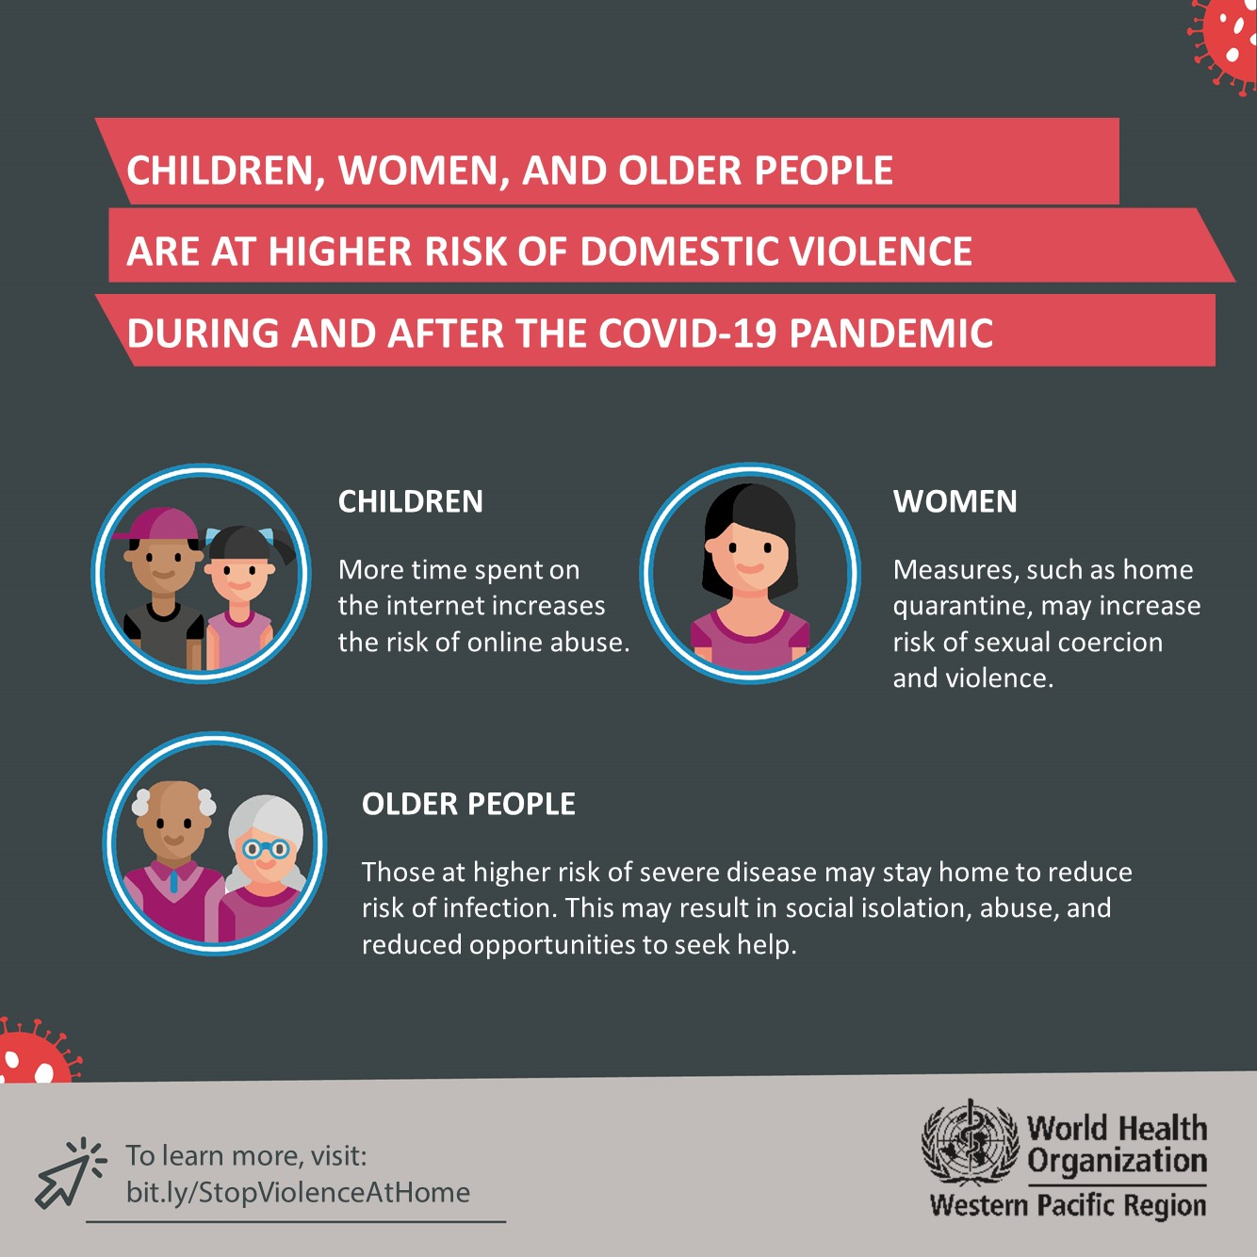
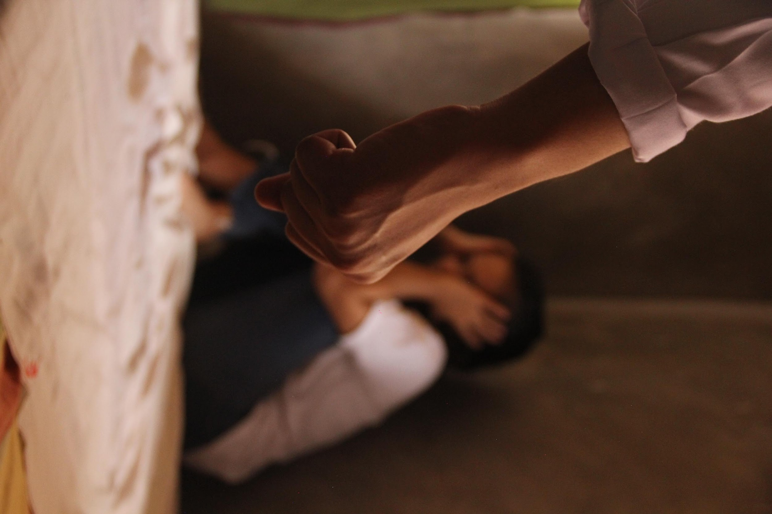
INTRODUCTION
ABUSE
“Is defined as an act of violence and/or maltreatment towards a person or things.”

Slide 4

INTRODUCTION
Republic Act No. 9262
“Anti-Violence Against Women and Their Children Act of 2004”
4 TYPES:
Physical
Sexual
Psychological
Economic

Slide 5
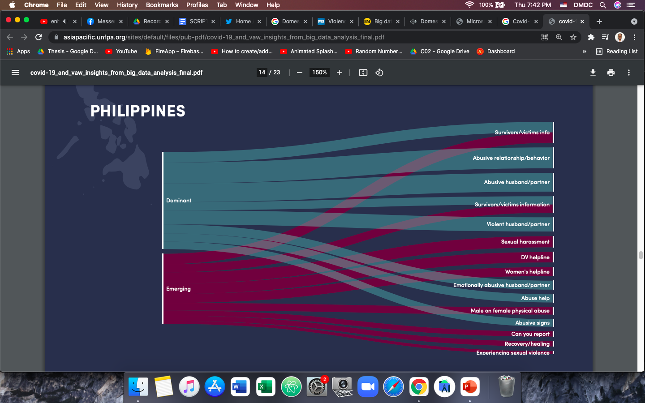
COVID-19 AND VIOLENCE AGAINST WOMEN: THE EVIDENCE BEHIND THE TALK
Insight from big data analysis in Asian Countries
Emerging refers to low volume of searches with high growth in the reference period.
Dominant refers to high volume of searches with high growth during the reference period.
Reference link: https://asiapacific.unfpa.org/en/publications/covid-19-and-violence-against-women-evidence-behind-talk

Slide 6
#31b: A 117 EMERGENCY COMMUNICATION PLATFORM FOR ABUSE REPORT IN A MOBILE APPLICATION

Slide 7
#31b:
“vertical reflection of the word ‘HELP’...”

Slide 8
RESEARCH OBJECTIVES

Slide 9
RESEARCH OBJECTIVES
PROVIDE CONTACT INFORMATION
Indicating the available Emergency Hotlines and office location of the Municipal Police Stations.
PROVIDE A MOBILE APPLICATION
That will be able to help the user to easily file or report an abuse.
PROVIDE ACCURATE DATA of CASES
To deliver support or comfort service to the victims, that can raise awareness with the discrete classification of abuse.

Slide 10
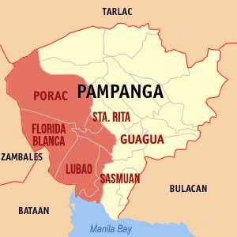

TARGET LOCALE AND RESPONDENTS
2nd DISTRICT OF PAMPANGA
RESPONDENTS CHARACTERISTICS
MUNICIPALITIES
Thirteen (13) years old and above,
Residing in the municipalities located in the 2nd District of Pampanga
Victims or
Witnesses of Abuse
Male, Female, LGBTQ+
FLORIDABLANCA
GUAGUA
LUBAO
PORAC
SANTA RITA
SASMUAN

Slide 11
RESEARCH OBJECTIVES
a.) PROFILE OF THE VICTIM or the COMPLAINANT
Full Name
Age
Sex
Address
Contact Information
Type of Abuse
Physical Abuse
Sexual Abuse
Psychological Abuse
Economical Abuse
Unknown Type of Abuse
b.) THE AUTHORITIES WILL DETERMINE THE FOLLOWING:
Total number of Abuse Cases per Municipality
Total submitted complaint per Type of Abuse
Range of Victims Age per Type of Abuse in a certain Municipality
Range of Offenders Age per Type of Abuse in a certain Municipality
Offenders’ Information
Name
Age
Sex
Physical and/or Emotional State

Slide 12
RESEARCH OBJECTIVES
c.) DATA WILL BE USED AS REFERENCE
to ignite and provide more help services in the area.
Counselling
Rehabilitation Support Service
Women and Children Protection Desk (WCPD)
Department of Social Welfare and Development (DSWD)
Non-Government Organizations (NGOs)

Slide 13
RELATED STUDIES

Slide 14

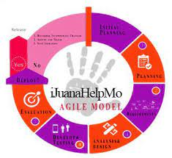
RELATED STUDIES
iJuanaHelpMo: Web and Mobile Application for Reporting Violence: A Framework for Developing Violence Against Women Application | #31b: A 117 Emergency Communication Platform for Abuse Report in a Mobile Application
SMS-Contact Relative/Family | Complaint Form
Mobile Application | Mobile and Web Application
VAW Information | Information Board
Counselling | Social Services Info
Assistance for Shelter and job | Health Care Services
Victims Social Media Hub | Complaint Report Charts
 | Municipal Police Emergency Hotlines
 | Admin Website for Database (for the Police)

Slide 15
SCOPE and DELIMITATIONS

Slide 16
SCOPE and DELIMITATIONS
The application can only be access if there is an internet connection.
The age range of the respondent will be from thirteen (13) years old and above.
The application will only focus on data gathering on the following:
a.) User’s Primary Information (for the Sign up)
b.) Victim’s Primary Details (for the abuse complaint form)
c.) Offender’s Primarily Details (for the abuse complaint form)
d.) data gathering and the connection of the application from the mobile application into the admin website that can be accessed by the appointed in-charge #31b Emergency Officer per designated Municipality.
e.) All data gathered will be protected and preserved under the Republic Act No. 10173 or the Data Privacy Act of 2012.

Slide 17
SCOPE and DELIMITATIONS
f.) The Municipal Police Stations covered in the study will only be the municipalities under the Second District of Pampanga.
g.) The Realtime database (Firebase) will be limited, and will need a database subscription.
h.) Only Android Phones will be accommodated by the mobile application.
i.) The mobile application only displays and suggest all the contact information (for the social services and health care services), further process are not included or carried out by the mobile application.
j.) The statements of the witnesses will be noted by the police station in the written report once the abuse case was settled for filing. Further processes such as the acknowledgement of the witness and its statement is not covered by the application, for this process is done by the court.

Slide 18
SCOPE and DELIMITATIONS
k.) The website application only caters to the super administrators and administrators. The administrators can file a report directly using the website, view data tables of cases per municipality, view data visualization of cases per municipality, and create user accounts for #31b mobile application while the super administrators have higher privileges than the administrators, which are as follows: creates admin accounts, view list of admin accounts, and enable/disable admin accounts and gives user roles.
l.) In the mobile application the users can view their personal complaint history log by browsing the list of reference numbers of their previous complaints.

Slide 19
SIGNIFICANCE OF THE STUDY

Slide 20
SIGNIFICANCE OF THE STUDY
The proposed study benefits in identifying the abuse cases and raising awareness against it, specifically in the Municipalities covered by the Second District of Pampanga which are:
Floridablanca, Guagua, Lubao, Porac, Santa Rita, and Sasmuan, through the use of a mobile application.
The local authorities will be able to receive the complaints sent from the mobile application. The data gathered from the complaints will be seen in data tables and will be used to monitor the abuse cases occurring in the locale.
The proposed study benefits the users by providing a system that would assist them to report the dangerous situation that they experienced. The mobile application will enable them to describe their situation and report it to the authorities.
The study could also serve as a reference for other possible developments for violence against women emergency communication hotline or awareness.

Slide 21
METHODOLOGY

Slide 22

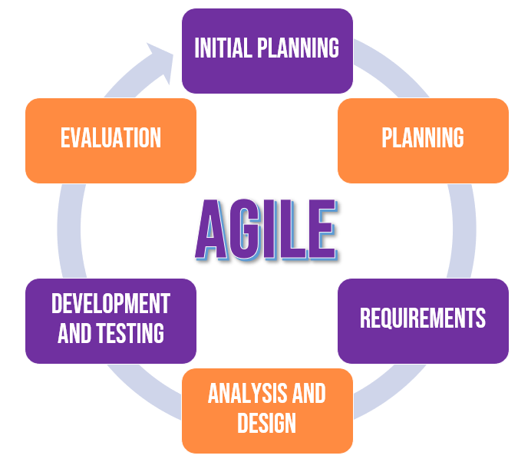
METHODOLOGY
SYSTEMS DEVELOPMENT
METHODOLOGY
RESEARCH DESIGN
Quantitative

Slide 23
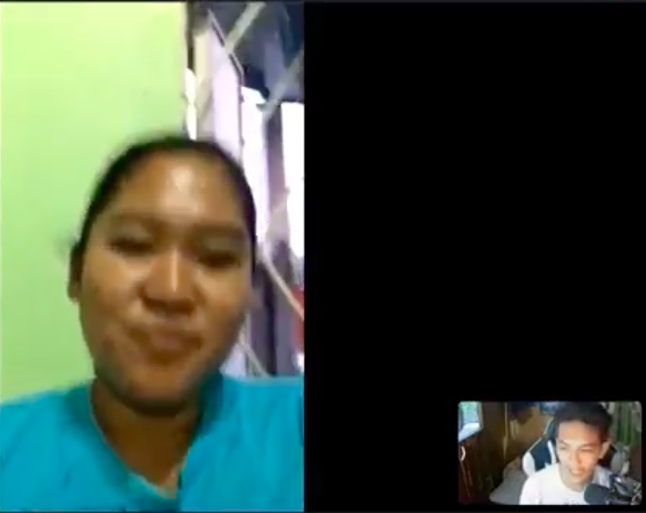

RESEARCH INSTRUMENT
METHODOLOGY
A self-made survey questionnaire through Google Forms.
INTERVIEW
Former Women and Children Protection Desk (WCPD) Officer in Lubao, Pampanga.

Slide 24
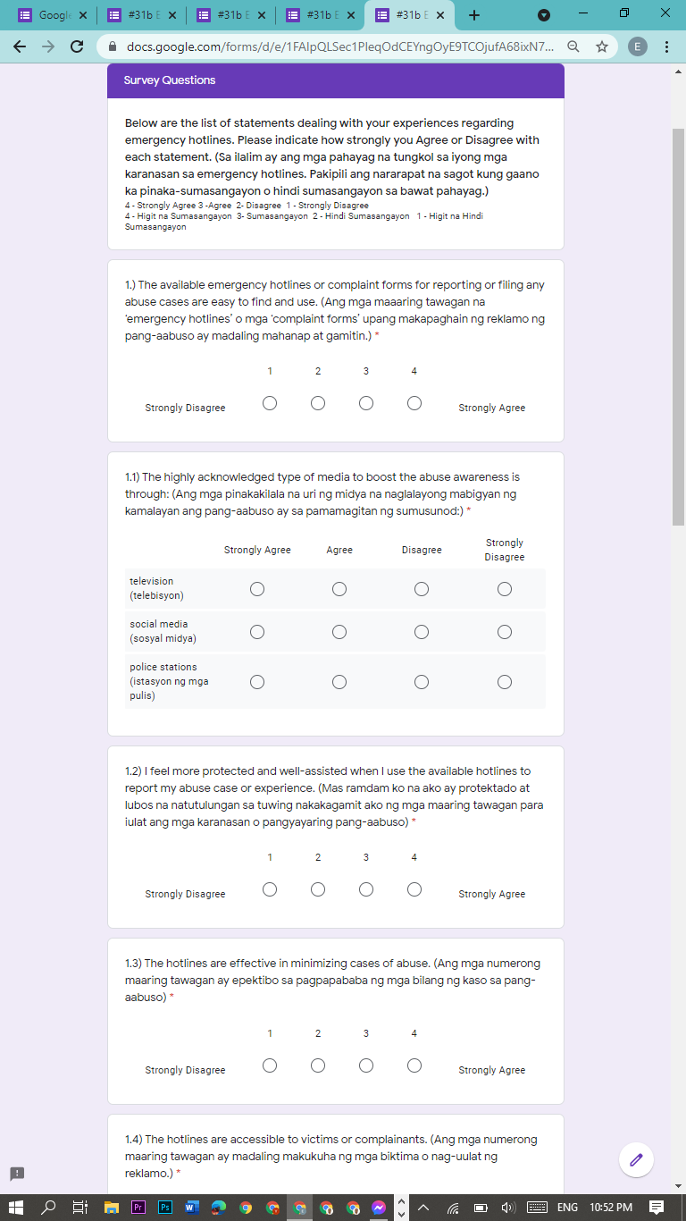
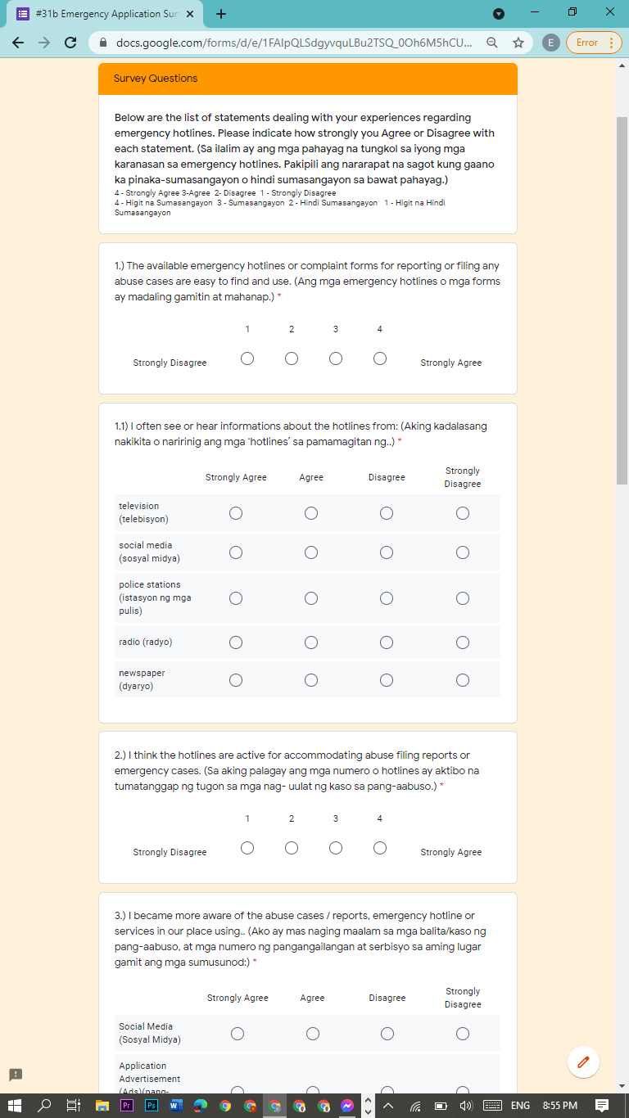
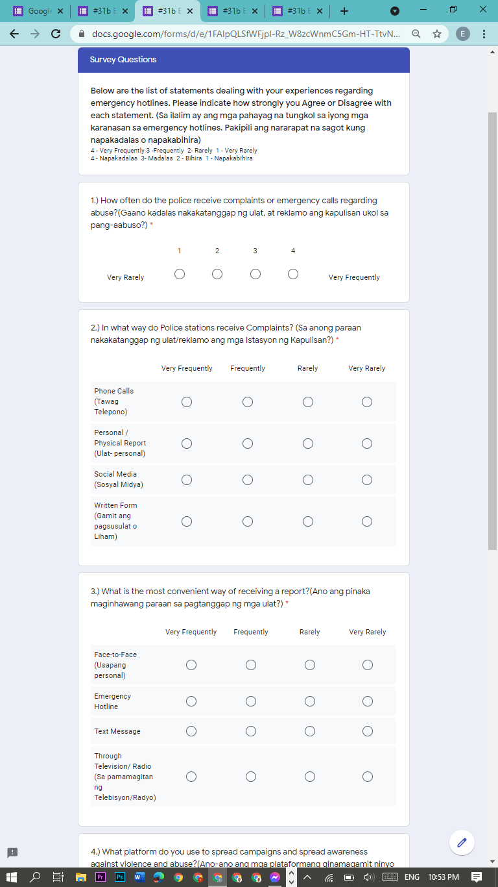
QUESTIONNAIRE
Victim/Witness
Pampanga Resident
Police Officer

Slide 25
METHODOLOGY
Organizational Assessment of Subjects
RANDOM CLUSTER SAMPLING
RESPONDENTS CHARACTERISTICS
377 Respondents
2nd District of Pampanga
Thirteen (13) years old and above,
Residing in the municipalities located in the 2nd District of Pampanga
Victims or
Witnesses of Abuse
Male, Female, LGBTQ+

Slide 26
METHODOLOGY
DATA ANALYSIS
The system was evaluated using the software quality standard called International Organization for Standardization (ISO) / International Electrotechnical Commission (IEC) 25010. The researchers followed the standard of ISO/IEC 25010 to categorize the mobile application functionalities.
The ISO/IEC 25010 categorization of software quality requirements are follows:

Slide 27
METHODOLOGY
DATA ANALYSIS
functional stability - to know what the mobile application does,
performance efficiency - to know if the mobile application uses an optimal amount of resources,
usability - to know if the specific user can use the mobile application in specific condition,
reliability - to know if the mobile application is stable enough to cater the needs of the user,
security - to know if the mobile application can protect information and data, (Britton, 2019)

Slide 28
METHODOLOGY
DATA ANALYSIS
The researchers used Likert Scale to analyze the statistical data from the survey questionnaires and the evaluation tool. The researchers chose a four-point scale:
1 – Strongly disagree: 2 – Disagree: 3 –Agree: 4 –Strongly Agree. The gathered data was analyzed using the weighted mean and interpreted.
WM = ΣWV / N
Where: WM = means weighted mean
WV= means weighted value
N = means number of cases
Σ = means summation
POINT | SCALE RANGE | INTERPRETATION
4 | 3.26 - 4.00 | Strongly Agree
3 | 2.51 - 3.25 | Agree
2 | 1.76 - 2.50 | Disagree
1 | 1.00 - 1.75 | Strongly Disagree

Slide 29
RESULT and DISCUSSION

Slide 30
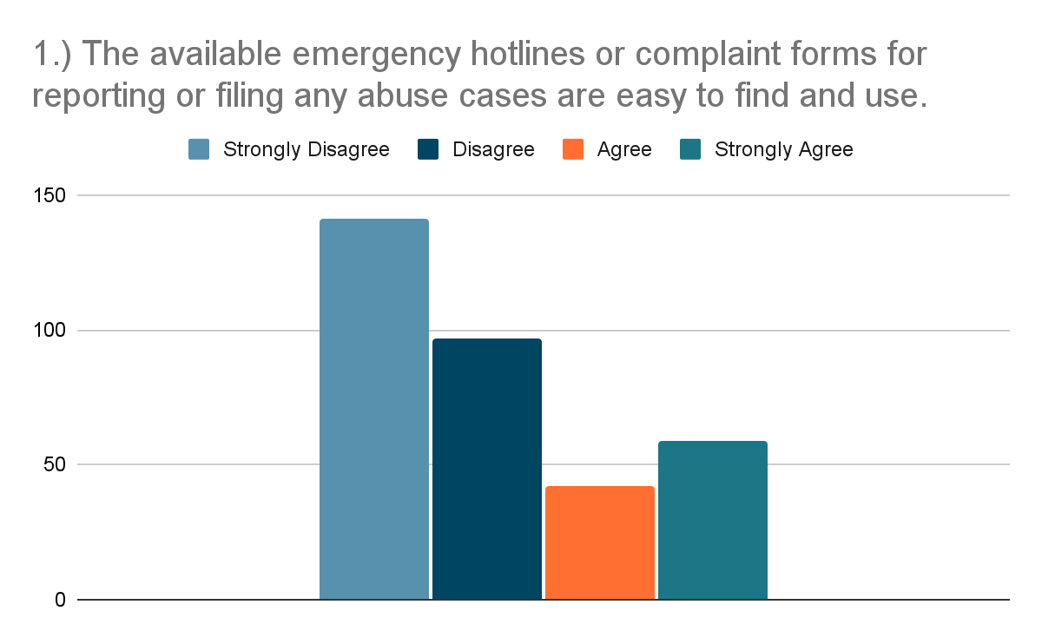
RESULT AND DISCUSSION
PRE-SURVEY RESULTS
42% of the respondents strongly disagreed and 29% of the respondents disagreed with the statement that the available emergency hotlines for filing abuse cases are easy to find and use.

Slide 31
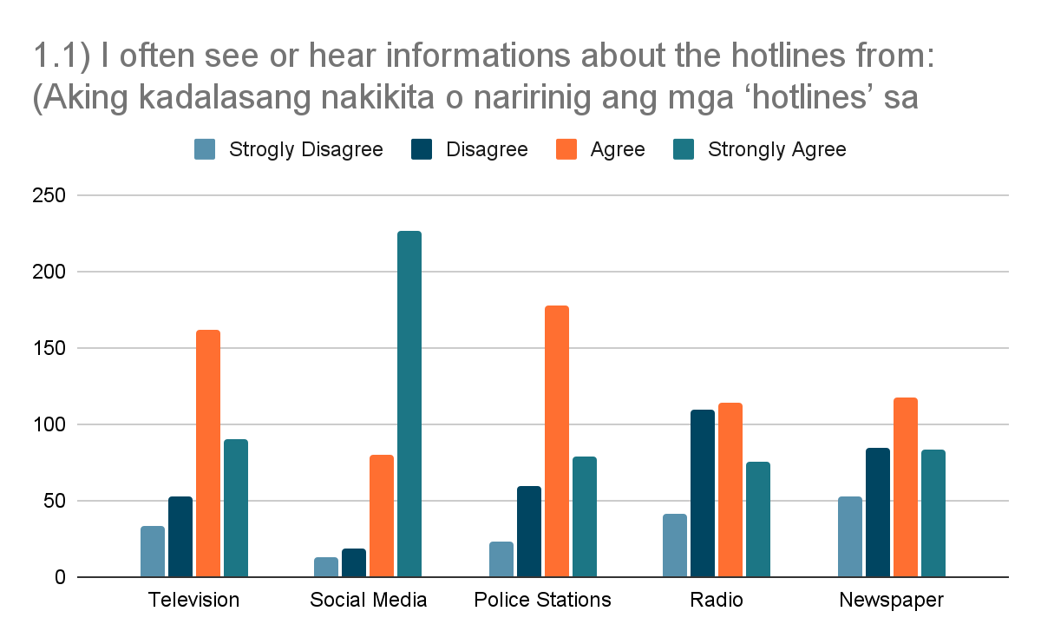
RESULT AND DISCUSSION
PRE-SURVEY RESULTS
67% of the respondents strongly agree that they often see or hear information about hotlines from social media platforms.

Slide 32
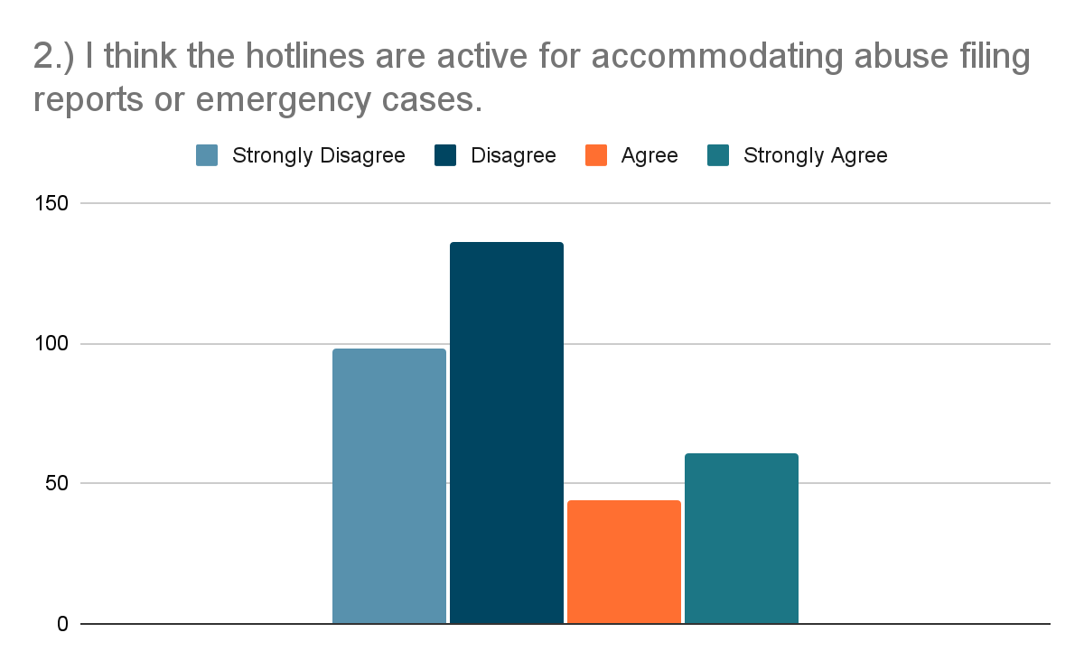
RESULT AND DISCUSSION
PRE-SURVEY RESULTS
Pampanga residents showed disagreement with a percentage of 69% to the statement that says hotlines are active for accommodating abuse filing or emergency cases.

Slide 33
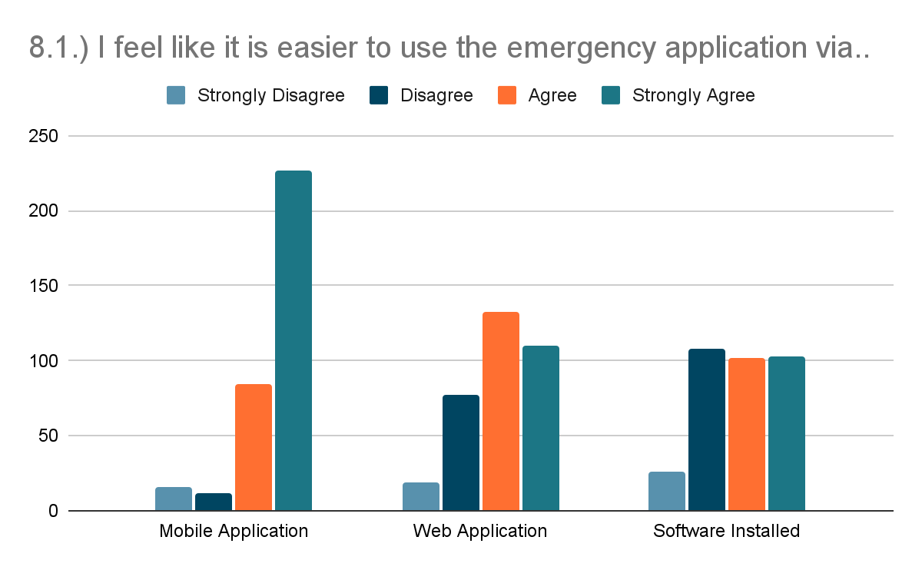
RESULT AND DISCUSSION
PRE-SURVEY RESULTS
The bar graph shows the results of the survey questionnaire for the Pampanga residents. 82% of the respondents agreed to look forward to using an application that can provide an emergency communication platform.

Slide 34
RESULT AND DISCUSSION
EVALUATION RESULTS SUMMARY
 | EXISTING SYSTEM |  | PROPOSED SYSTEM
Indicators | Mean | Interpretation | Mean | Interpretation
Functional Stability | 2.52 | Agree | 3.71 | Strongly Agree
Reliability | 2.42 | Disagree | 3.69 | Strongly Agree
Usability | 2.52 | Agree | 3.77 | Strongly Agree
Performance Efficiency | 2.48 | Disagree | 3.70 | Strongly Agree
Security | 2.65 | Agree | 3.77 | Strongly Agree
AVERAGE MEAN | 2.52 | Agree | 3.73 | Strongly Agree

Slide 35
RESULT AND DISCUSSION
EVALUATION RESULTS SUMMARY
For the summary result shown in table, the representation indicates that the proposed system impact has an average mean of 3.73, which corresponds to an interpretation level equivalent to “Strongly Agree”, specifying that the proposed system’s average mean (3.73) compared to the existing system’s average mean (2.52), with an interpretation level of “Agree”, which is shown in table. With a difference of (1.21) in the average means where in the proposed system resulted higher, this signifies that the proposed system has a greater impact and advantage to the users than the existing system in terms of functional stability, reliability, usability, performance efficiency and security.

Slide 36
RESULT AND DISCUSSION
DISCUSSION
The application offers a complaint report function through the use of the internet.
Through the use of the application, the database of the complaint reports will be organized as the application only focuses on submitting reports and also giving reliable information for better awareness of the people.
One of the objectives of the study is to provide accurate information about the local authorities such as telephone numbers and locations.
Also, providing the information about the nearby facilities that could help for the betterment of a person’s well-being.
An information board that also tackles on how to identify if a person is being abused and what are the ways to report the abuse and stop it.
All of these are utilized in one application that will give benefit to the users.

Slide 37
CONCLUSION and RECOMMENDATION

Slide 38
CONCLUSION
The overall study was concluded successful as the aim and objective of the #31b: A 117 Emergency Communication Platform for Abuse Report in a Mobile Application was met successfully. The application was able to provide an additional way of submitting a complaint report to the authorities. Also, by providing helpful information such as emergency hotlines, stations, institutions and facilities for the victims. Through the months of development using the agile methodology, the system showed strengths and underwent many improvements of its features and functionalities. In the evaluation survey, the respondents found out that they Strongly Agree in terms of security with an average mean of 3.77%, usability with an average mean of 3.77% and functional stability with an average mean of 3.71%. Therefore, the researchers concluded that the results are in line with the overall quality of the proposed system.

Slide 39
RECOMMENDATION
The researchers recommend the following improvements and additional upgrade features for the next researchers that would like to take the similar study:
Firstly, the adjusting and enhancement of the administrator’s website and mobile application appearance;
adding more functionality for data visualization;
additional language support for local users; and
a new user sign-up authentication feature using the National Identification number issued by the Philippine Statistics Authority (PSA).
Furthermore, for more prospective implementations and approaches of this study, the System Development Life Cycle is the one to take in mind of the next researchers. The use of multi-platform application development can address the accessibility and usability to different mobile operating systems, to accommodate and help more users.

Slide 40



THANK YOU!
GROUP CO2
Alonzo, Arlene Grace C. Belleza, Ram Rainier M. Dela Cruz, Diane Louise M. Magat, Mharck Stephen P. Mañalac, Gerald O. Pineda, John Carlo C. Soriano, Justine G.
BSIT- 4A

